Slide 1
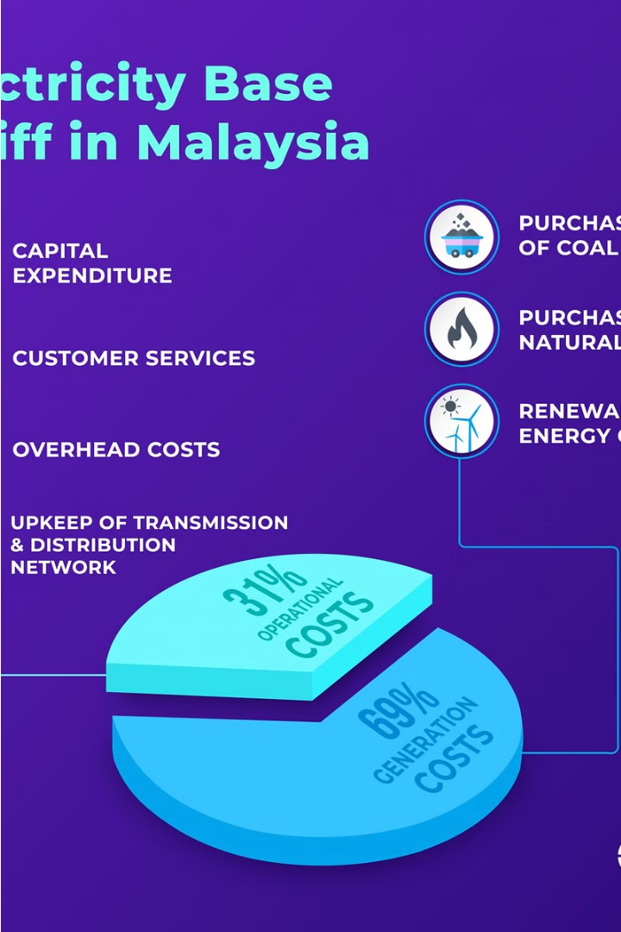


Introduction to Tariffs in Electrical Technology
Tariffs are the pricing structures used by electricity providers to determine the cost of power for their customers. Understanding the different types of tariffs is crucial for consumers, businesses, and policymakers in the electrical technology sector.
by Ayush

Slide 2
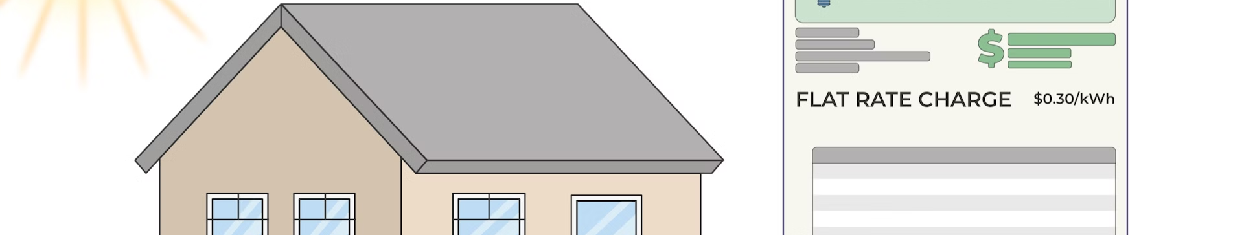
Flat Rate Tariff
A flat rate tariff is a simple and straightforward electricity pricing structure. Customers are charged a fixed rate per unit of electricity consumed, regardless of the time of day or the total amount used. This approach provides predictable and consistent billing, making it easy for consumers to budget their energy costs.

Slide 3
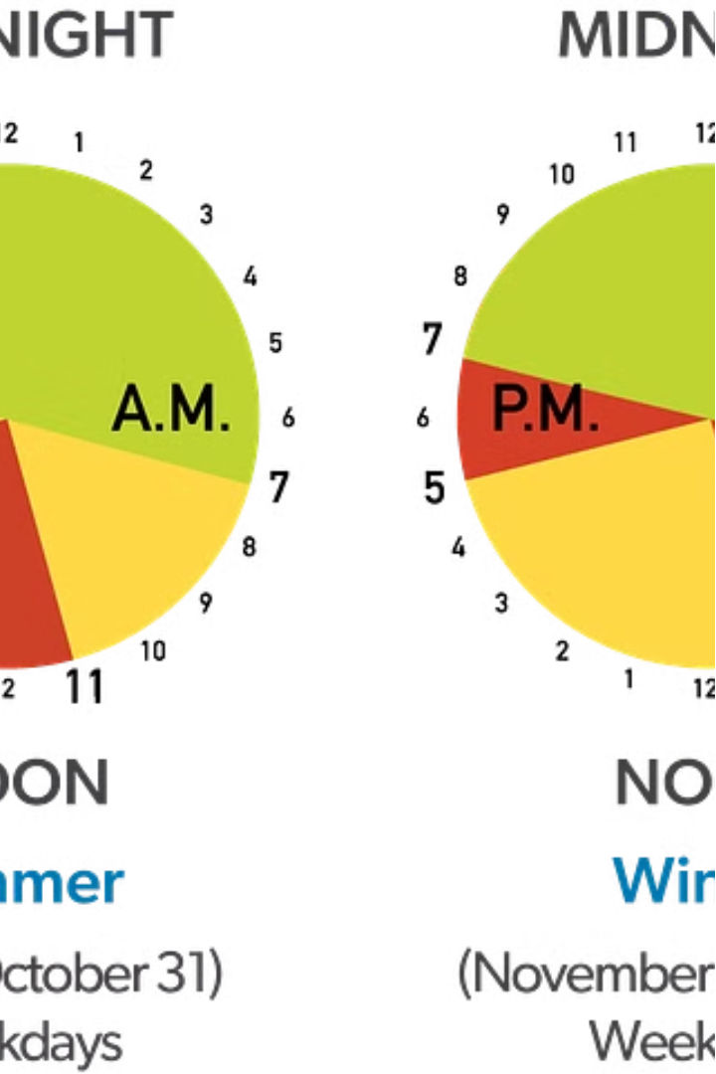
Tiered Tariff
A tiered tariff is a pricing structure where the cost per unit of electricity increases as the total consumption exceeds certain thresholds. This encourages energy conservation by making higher usage more expensive. Customers are typically charged a lower rate for initial blocks of usage, with rates rising for subsequent tiers.

Slide 4
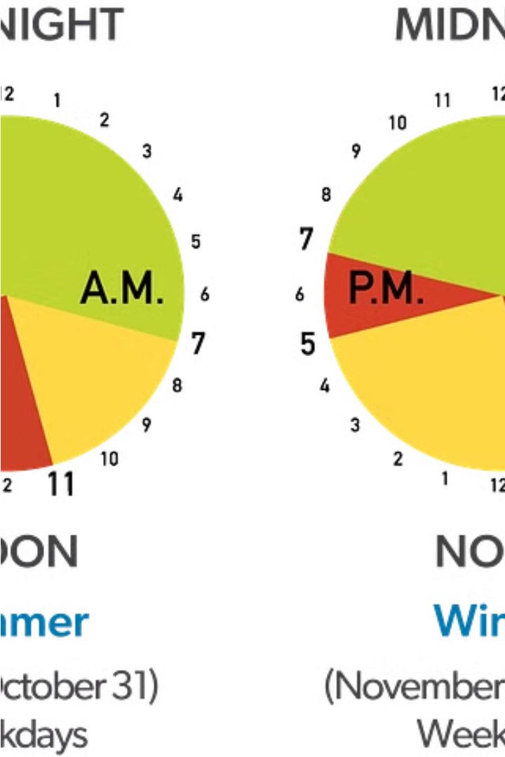
Time-of-Use Tariff
A time-of-use (TOU) tariff is an electricity pricing structure that varies the rate based on the time of day. Customers are charged higher rates during peak demand hours, such as evenings, and lower rates during off-peak hours, like nights and weekends. This approach incentivizes consumers to shift their energy usage to lower-cost periods, helping to balance the grid and reduce strain on the electrical system.

Slide 5
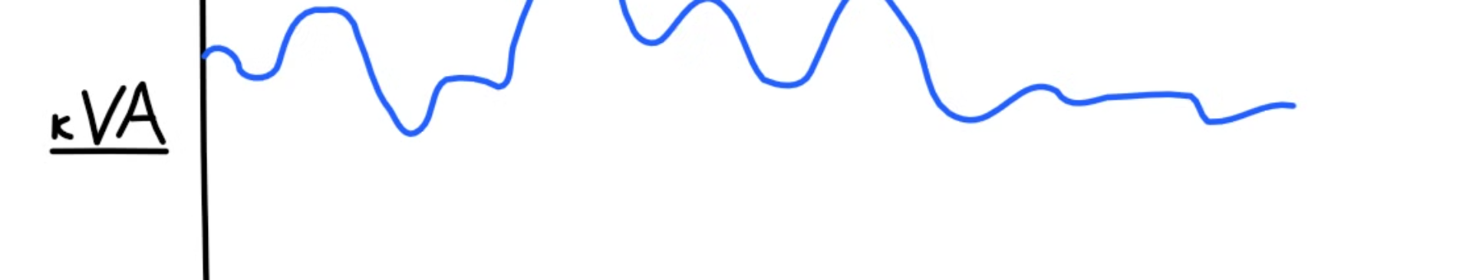
Demand-Based Tariff
A demand-based tariff is an electricity pricing structure that charges customers based on their maximum power consumption, or "demand," rather than just their total energy usage. This incentivizes customers to reduce their peak power draw, which can help utilities better manage grid capacity and avoid costly infrastructure upgrades.

Slide 6
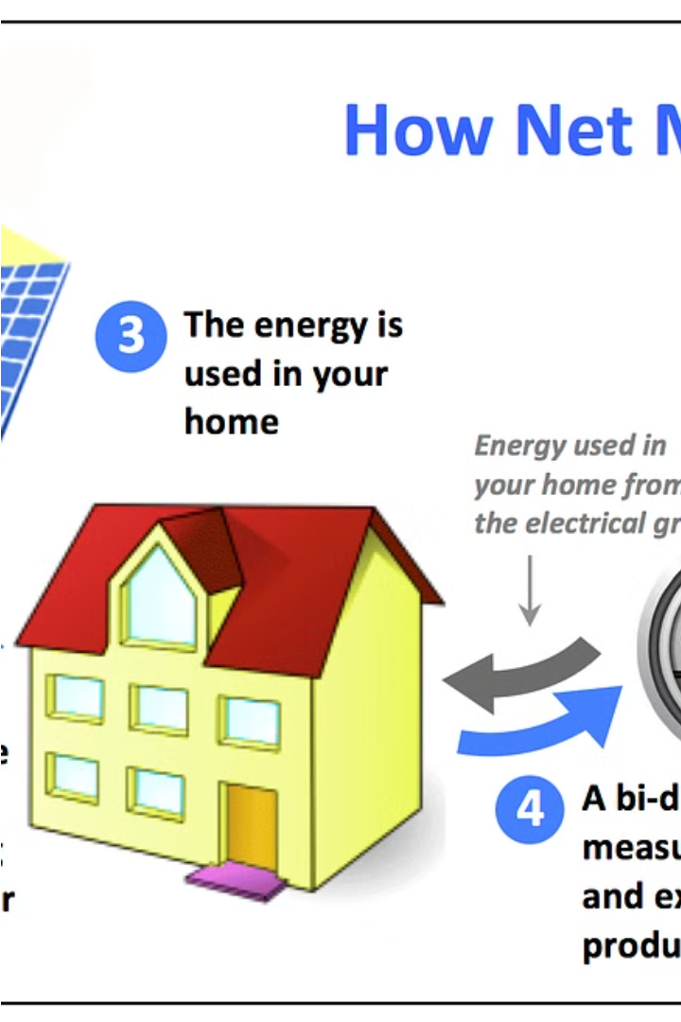
Net Metering Tariff
A net metering tariff is a policy that allows customers with on-site renewable energy generation, such as solar panels, to feed excess electricity back into the grid and receive credit for it. This encourages the adoption of distributed renewable energy sources and helps customers offset their electricity bills.

Slide 7
Feed-in Tariff
A feed-in tariff is a policy mechanism that provides a guaranteed, above-market rate for electricity generated from renewable sources, such as solar or wind power. This incentivizes the adoption of renewable energy by allowing producers to be compensated for the electricity they feed into the grid. The higher rates help offset the initial investment costs and make renewable projects more financially viable.

Slide 8

Interruptible Tariff
An interruptible tariff is an electricity pricing structure where customers agree to have their power supply temporarily interrupted by the utility during periods of high demand or grid instability. In exchange, these customers receive discounted electricity rates. This approach helps utilities manage grid capacity and avoid costly blackouts, while providing financial incentives for customers to participate.

Slide 9
Seasonal Tariff
A seasonal tariff is an electricity pricing structure that varies rates based on the time of year. Customers are typically charged higher rates during peak demand seasons, such as summer months when air conditioning usage is high, and lower rates during off-peak seasons. This approach helps utilities manage the strain on the electrical grid and encourages energy conservation during high-usage periods.

Slide 10
Factors Influencing Tariff Selection
Several factors influence the choice of electricity tariff structure, including:
Customer Energy Needs: Understanding the customer's typical usage patterns, such as peak demand and seasonal variations, helps select the most appropriate tariff.
Utility Grid Management: Utilities may favor tariffs that incentivize load shifting or distributed generation to better manage grid capacity and stability.
Policy and Regulatory Environment: Government policies and regulations can mandate or encourage certain tariff structures, such as feed-in tariffs for renewable energy.
Environmental Impact: Tariffs that promote energy efficiency and the adoption of renewable sources can help reduce the overall environmental footprint.
Economic Considerations: The tariff structure should balance the utility's revenue requirements with the affordability and fairness for customers.

